Slide 1



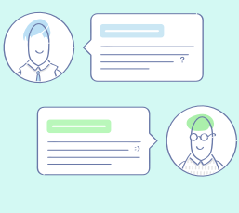
Predicting Technical Aptitude using Customer Conversations
Namit Agrawal | Neha Dipali | Bret Jaco
Meha Mehta | Vinay Pahwa | Aditya Soni
MS Business Analytics – Capstone Project
McCombs School of Business
The University of Texas at Austin

Slide 2
The Problem
Background and Objectives
Analysis and Insights
Preprocessing and Feature Engineering
Modelling
Recommendations
Outline
Notes:
Background and Objectives
Preprocessing and Feature Engineering – EDA and Data Cleaning
Analysis and Insights
Recommendations
Next steps

Slide 3
Background and Objectives
Purpose
To gain an understanding about different types of customers to improve personalization and enhance customer experience
Strategy
Utilizing customer support data provided by customer support team to conduct analyses and build text analytical frameworks
Are we able to develop a technical proficiency score using unstructured data from chat logs?
Are we able to identify dominant clusters among the customer groups?

Slide 4
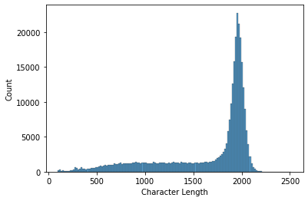
Preliminary Analysis and Insights
FISC_QTR_VAL | FISC_WEEK_VAL | Group_name | Region_name | Sub_Region_name | Case_number | Chat_Create_date | Chat_Txnsrpt_body
2021-Q1 | 2021-W01 | Client Basic Support Consumer | AMERICAS | United States | 49683308 | 2/2/2020 18:36 | <p align=center>Chat NAME: {{NAME}}, {{NAME}} 03, 2020, 00:06:38 (+0530)</p><p align=center>Chat NAME: NA.DB.INTP.CLI.CO.EN.PRESP.BLR</p><p align=center>Agent {{NAME}} {{NAME}}</p>( 16s ) {{NAME}} {{NAME}}: Hi, Thank you for contacting {{NAME}} technical expert, how may i help you.
Features to Note
Group_name : indicates type of customer
Chat_Txnsrpt_body : provides a transcript of the support conversation
Two types of customers: Commercial & Consumer
Chat transcripts have been truncated at 2000 characters – most transcripts are incomplete
Transcript length distribution of 306k samples

Slide 5
Preprocessing and Feature Engineering
100k sampled raw chat transcripts
Conversion to lower case
Removing anonymized identifiers, numbers
Removing timestamps, session IDs
Removing commonly used phrases
Retaining transcripts having >40 characters
<p align=center>Chat NAME: {{NAME}}, {{NAME}} 04, 2020, 12:59:24 (-0800)</p><p align=center>Chat NAME: NA.TS.CLI.CHAT.EN.CORE.COM.OPTLAT</p><p align=center>Agent {{NAME}} V</p>( 42s ) {{NAME}} NAME: Thank you for contacting {{NAME}} {{NAME}} {{NAME}}. My Name is {{NAME}}. Please give me a moment while I review your case details. ( 1m 10s ) {{NAME}} NAME: Hello {{NAME}}, How are you doing today? ( 1m 21s ) {{NAME}}: I&#39;m well thank you. ( 1m 38s ) {{NAME}} NAME: Glad to hear :) ( 1m 54s ) {{NAME}} NAME: I see that you are experiencing issue with your system as its {{NAME}} is failed, right? ( 3m 42s )
Thank you for contacting . My Name is . Please give me a moment while I review your case details.
Hello , How are you doing today?
I&#39;m well thank you.
Glad to hear :)
I see that you are experiencing issue with your system as its is failed, right?
I see that you are experiencing issue with your system as its is failed, right?

Slide 6
Performance Evaluation – Manual Labeling
Customer technical proficiency tagging – a novel problem. Absence of prior labelled transcripts
Need to manually define conversations to indicate technical proficiency of customers
Not Technically Proficient /
Insufficient Data
Technically Proficient
3
1
2
4
5
6
7
8
9
10
Manually labeled 300 conversations on a range of 1-10
Technical proficiency = re-install or update drivers, perform troubleshooting steps, knowledge of BIOS, knowledge of error codes, etc.
Recommendation for future scope - Using mechanical turks to augment labelled dataset

Slide 7
Modeling: TF-IDF
Cleaned chat transcript
Determining vocabulary from (subset of) transcripts
Scoring transcripts using vocabulary
Score Distribution analysis
Rescaling score range between
1-10
Comparing TF-IDF scores with manual scores
Unigrams
Bigrams
Assumptions
Examples of Key Words
Measuring Performance
Technically proficient customers use more technical terms
Conversations initiated by agents: Chats have alternating messages from agents and customers.
Agents are technically proficient
System
Battery
Power
Bios
Computer
Laptop
Dispatch
Update
File Transfer
Hard Drive
Power Button
Physical Damage
Docking Station
Operating System
Error Code
Compare classification accuracy by splitting into 2 categories based on median - 5
Check distributions and measure correlation
Model 1: Splitting transcripts into agent and customer chats
Model 2: Considering entire transcripts

Slide 8
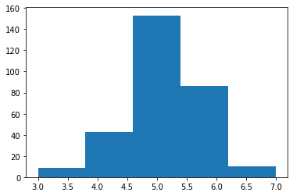
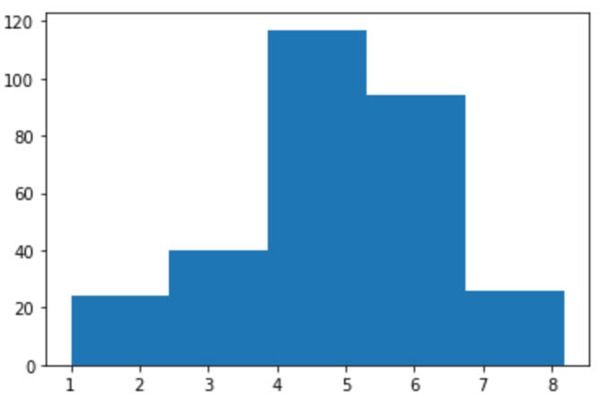
Comparing TF-IDF Models
Score Distribution
Confusion Matrix
Performance
 |  | TF-IDF Logic Output
 |  | FALSE | TRUE
Manual Scoring Output | FALSE | True Negative 36 11.9% | False Positive 102 33.8%
 | TRUE | False Negative 16 5.3% | True Positive 147 48.8%
Manually scored test set:
Correlation: 41%
Median Split Accuracy: 61%
Model 1
# Conversations
Scores
 |  | TF-IDF Logic Output
 |  | FALSE | TRUE
Manual Scoring Output | FALSE | True Negative 97 32.3% | False Positive 41 13.7%
 | TRUE | False Negative 62 20.7% | True Positive 101 33.7%
Manually scored test set:
Correlation: 44%
Median Split Accuracy: 66%
Model 2
# Conversations
Scores

Slide 9
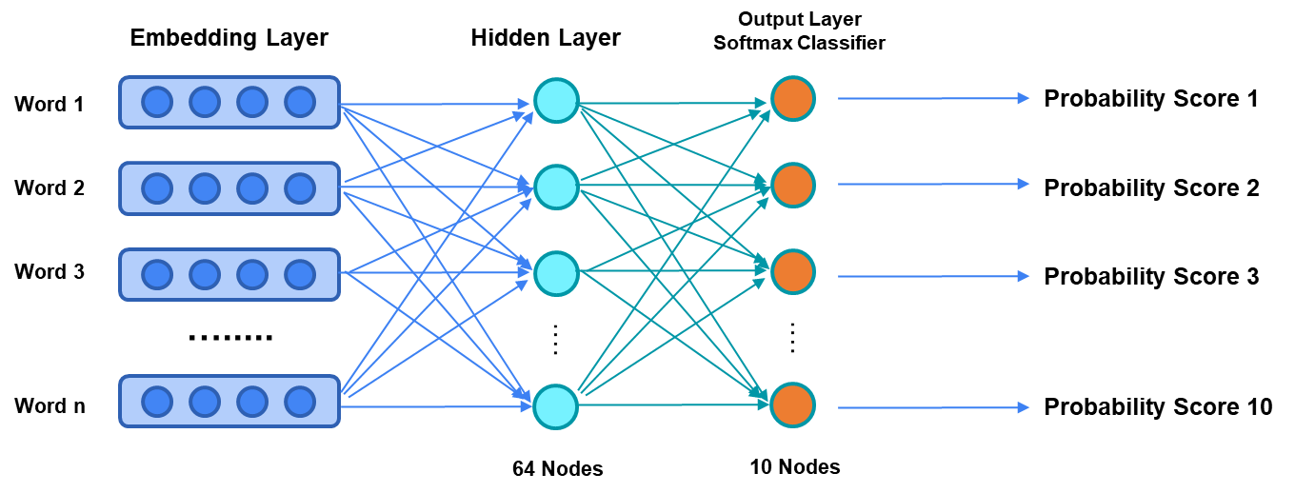
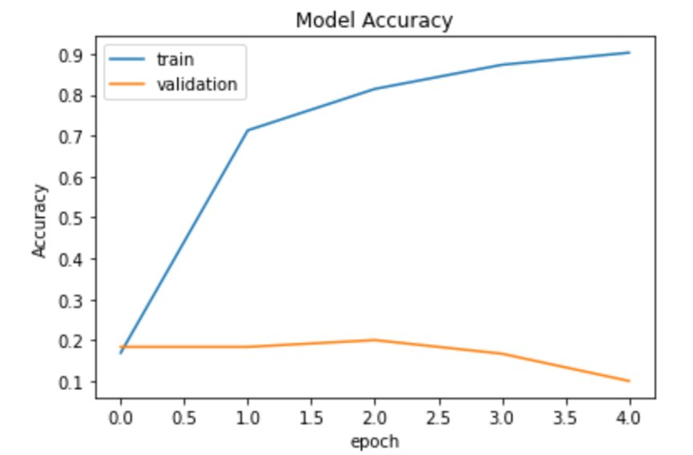
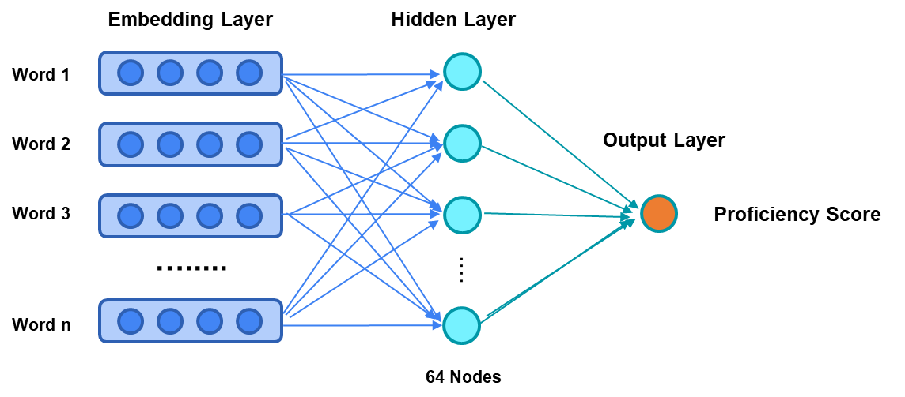
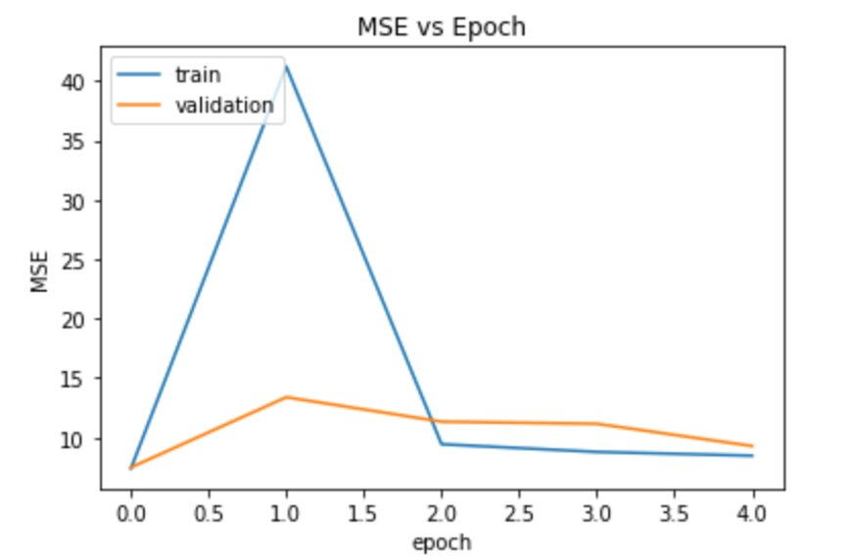
Modeling: Neural Networks
Classification
Regression
Validation MSE is stagnant around 10

Slide 10










Clustering
0 Service Tag | 1 Warranties | 2 Replacement Parts | 3 Software | 4 Abbreviations
aservicetagg plz dsp aservicetagb sir aservicetagw aservicetagi aservicetagm aservicetagh drt | warranty purchase purchasing warrenty reseller therefore discount order buy pay | part ost cx mobo insists declined denies refused insisted replace | bios driver window installs o rebooted utility reboot try generic | ty nah sweet kk partselection pn coolio improve yw man
5 Hardware | 6 Customer Support | 7 Power Issues | 8 Display Issues | 9 Conversation
system zone valid active est caused ensure confirming near physical | sent addresscontact dispatch tech part technician quote perfect mailed absolutely | power plugged unplugged plug adapter light plugging turn powered charger | computer system laptop monitor device display detects recognizes pc dock | response reply chatthank received minute disconnect conversation reponse connected kindly

Slide 11


Personas
Commercial & Proficient
“…so this laptop has had several issues with taking hours to boot up, restart, or shut down. when I try to image it I will get the BSOD. I’ve replaced the memory with known good working memory and I’ve replaced the hard drive with a known good working hard drive. I get the same results…”
Customer Group
Commercial versus Consumer
Proficiency Score
Technically Proficient versus Not Technically Proficient
Consumer & Not Proficient
“…no all the keys are working fine , touchpad and the touch button not working…”

Slide 12
Insights and Future Scope
Insights from Analysis
Overcoming Current Issues
Future Scope
De-anonymized transcripts will improve TF-IDF model accuracy
65% accuracy with given constraints
More labeled data will improve performance of NN and Word2Vec models
Personas help distinguish customers and will help agents more than just scores
Aggregating scores at customer level (for multiple case interactions)
Evaluating only customer transcripts with non-anonymized data
Using customer attributes to create personas
Using complete transcripts to instead of truncated chats
Manually tag more chat transcripts using mechanical turks
Analyze a larger sample of the data using better computing power

Slide 13
Questions?

Slide 14


Word2Vec
Encode the semantic meaning of what is being said to understand customer technical proficiency
Embedding Dimension: 300
bios
.787 | .981 | .076 | -.872 | .231 | -.112 | .543 |  | -.912
display
.235 | -.674 | .863 | -.984 | .467 | -.653 | .299 |  | .101
disconnect
-.653 | .451 | .347 | .276 | .873 | .277 | -.786 |  | .982
warranty
.488 | .286 | .423 | -.652 | .568 | .111 | .375 |  | -.854

